Slide 1
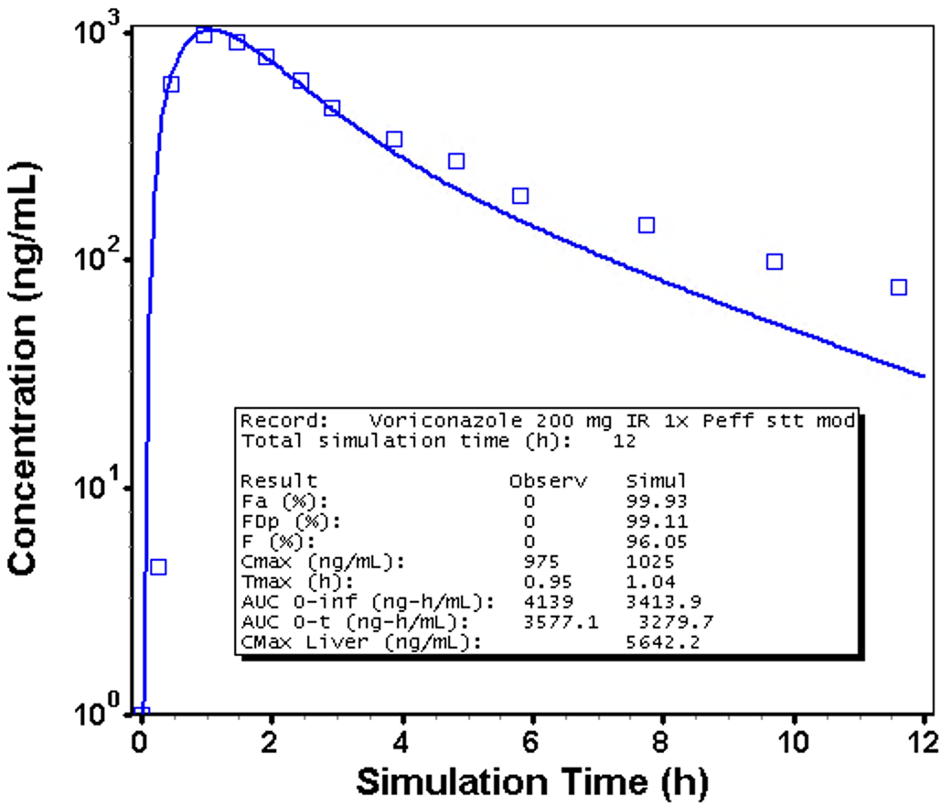
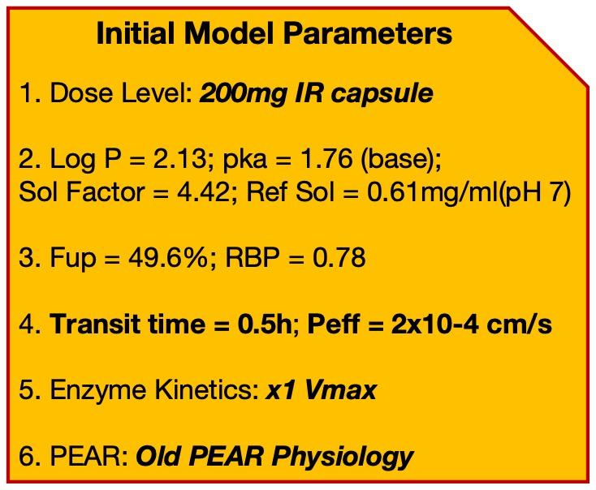
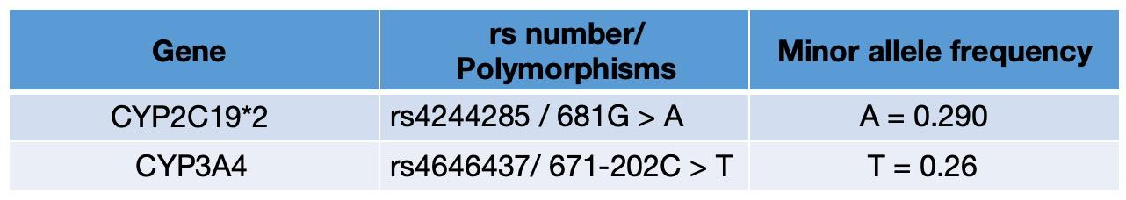

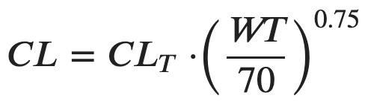
Jiaqi Fu - Voriconazole - Outline
Introduce initial Model which will be applied as a test
Introduce new PEAR physiology
Genotypes:
Therapeutic Window & Define a proper dose level
Hypothesis & Conclusions
Cmax_bias% = +5.13%
AUC_bias% = -8.31%
Old PEAR Physiology
CYP2C19*2/*2 genotype exhibited Vmax rate of 9% of CYP2C19*1/*1.
CYP3A4 rs4646437 CT genotype induces lower expression, causing a relatively higher Cmax and AUC compared to homozygous(CC / TT) genotypes.
26-year-old Male
Height: 176.36cm
Weight: 71kg
CL(Adult): 24.16 L/h
New PEAR Physiology
6-year-old Male
Height: 119.28cm
Weight: 21.7kg
CL(child): 10 L/h
Notes:
References:
Chuwongwattana S, Jantararoungtong T, Prommas S, Medhasi S, Puangpetch A, Sukasem C. Impact of CYP2C19, CYP3A4, ABCB1, and FMO3 genotypes on plasma voriconazole in Thai patients with invasive fungal infections. Pharmacol Res Perspect. 2020 Dec;8(6):e00665. doi: 10.1002/prp2.665. PMID: 33124772; PMCID: PMC7596670.
de Jong LM, Boussallami S, Sánchez-López E, Giera M, Tushuizen ME, Hoekstra M, Hawinkels LJAC, Rissmann R, Swen JJ, Manson ML. The impact of CYP2C19 genotype on phenoconversion by concomitant medication. Front Pharmacol. 2023 Jun 8;14:1201906. doi: 10.3389/fphar.2023.1201906. PMID: 37361233; PMCID: PMC10285291.

Slide 2
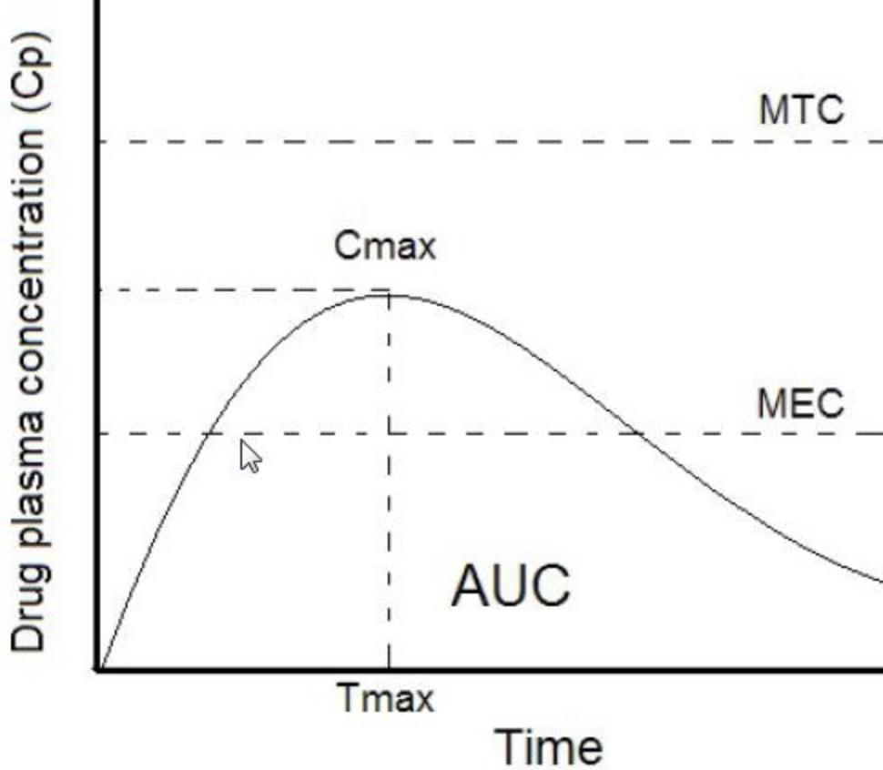
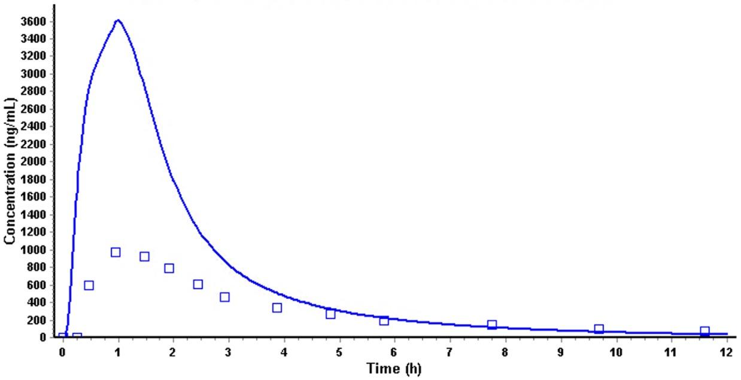
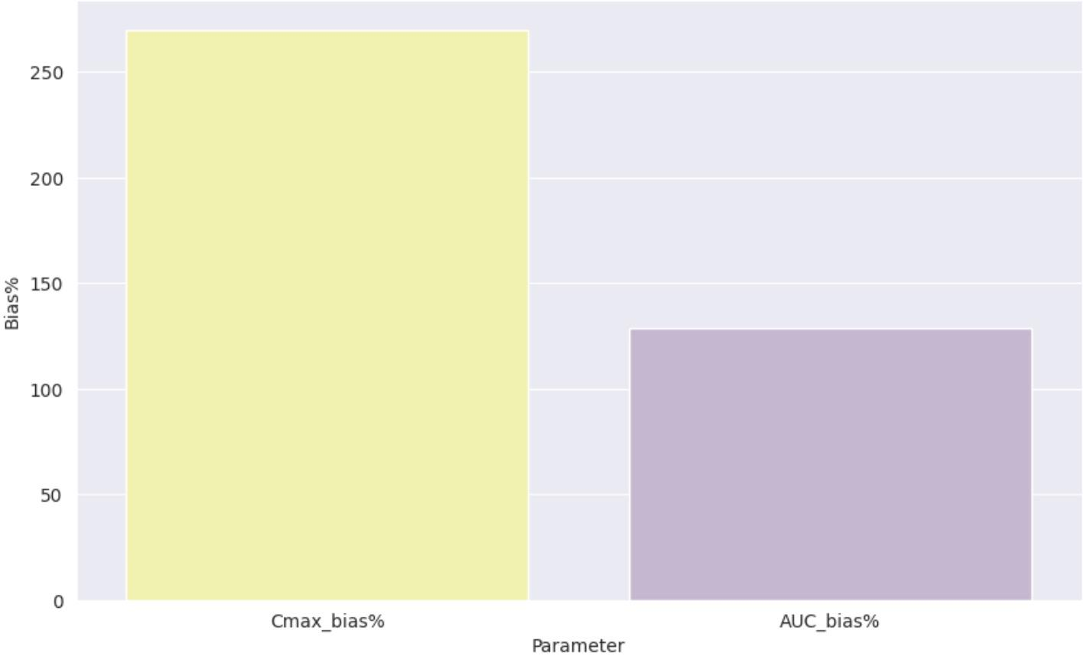
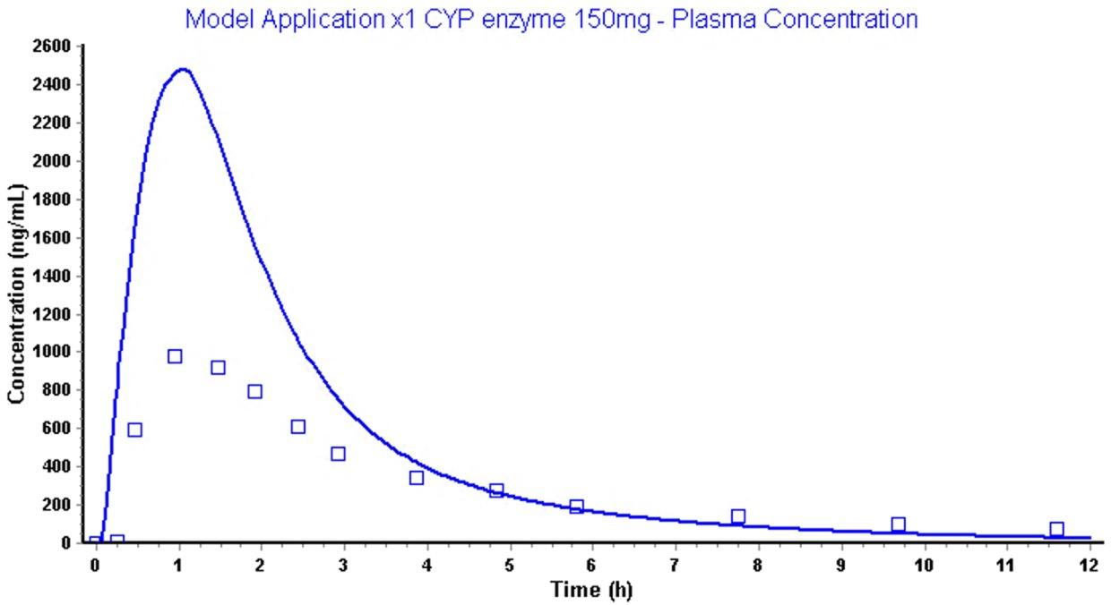
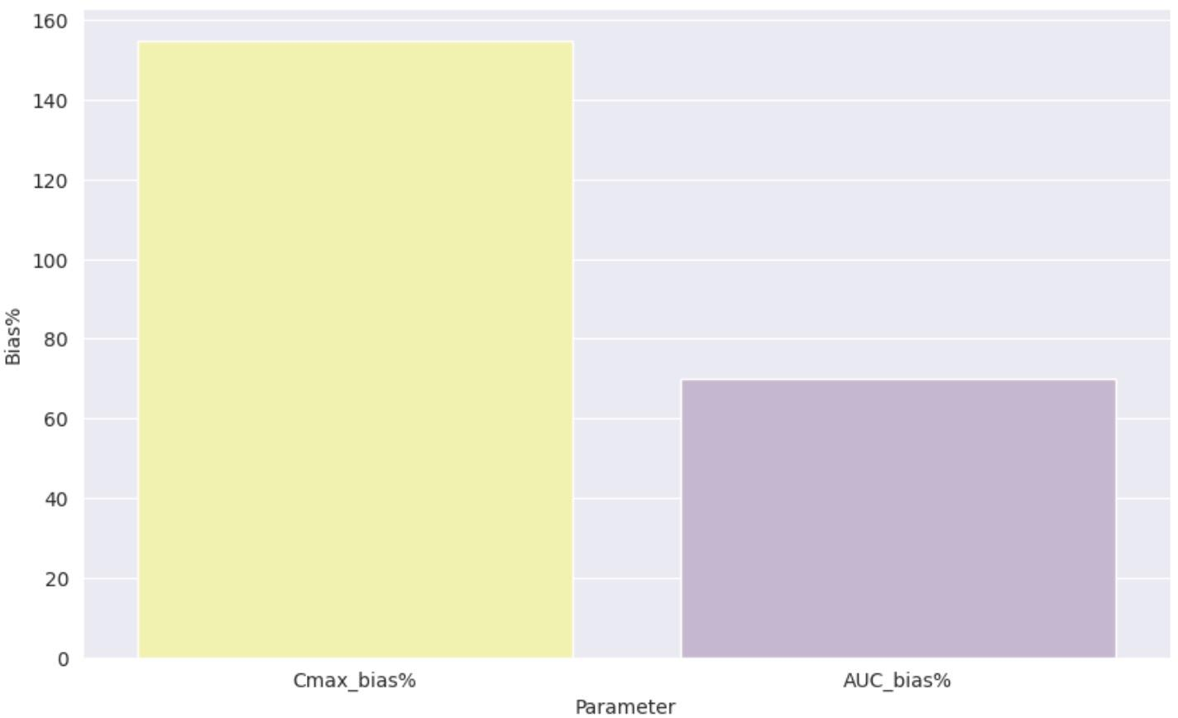
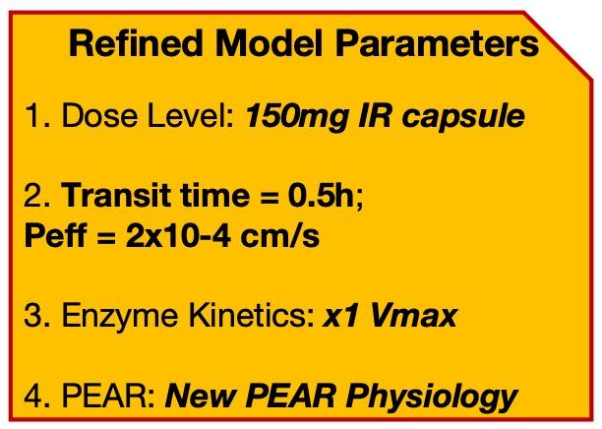
Therapeutic Window:
Test on 200mg IR Capsule:
5.5 mg/L
3.6 mg/L(Cmax) < 5.5mg/L(MTC)
270%
Cmax_sim ~= 3.7 Cmax_obs
AUC_sim ~= 2.28 AUC_obs
1 mg/L
129%
1 mg/L
Test on 150mg IR Capsule:
2.49 mg/L(Cmax) < 5.5mg/L(MTC)
155%
Cmax_sim ~= 2.54 Cmax_obs
AUC_sim ~= 1.7 AUC_obs
1 mg/L
1 mg/L
70%

Slide 3
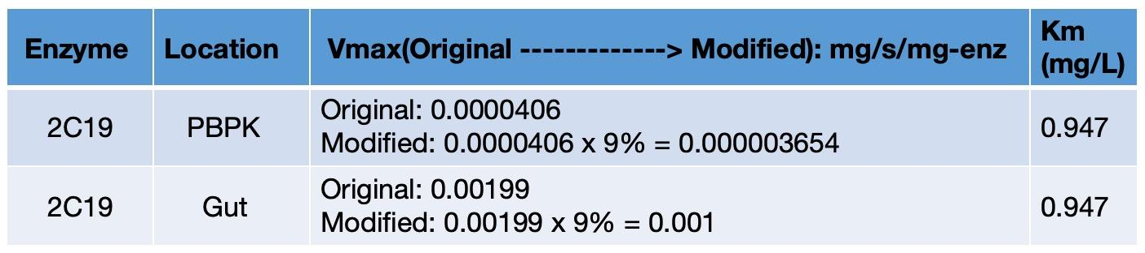
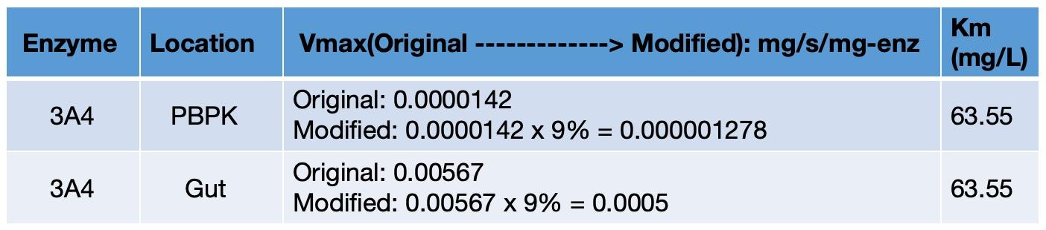
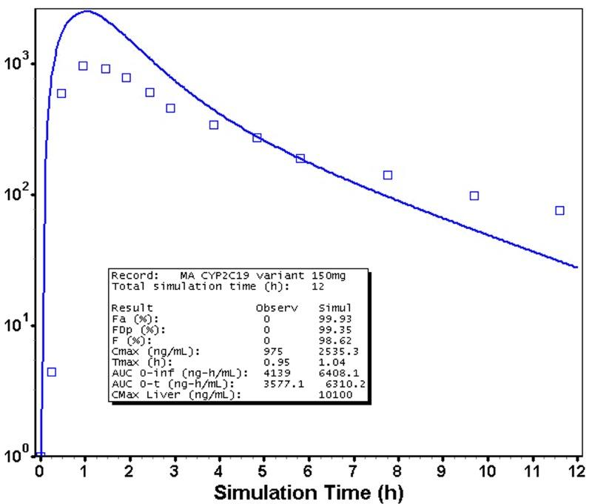
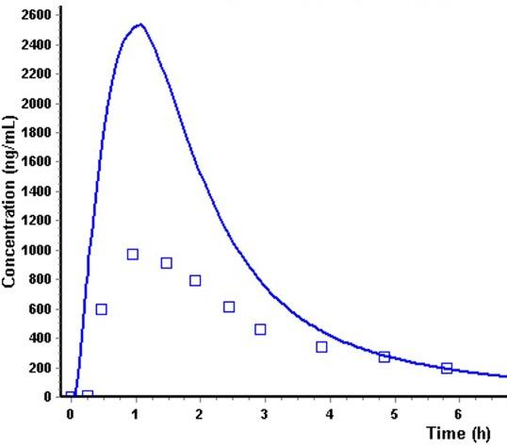
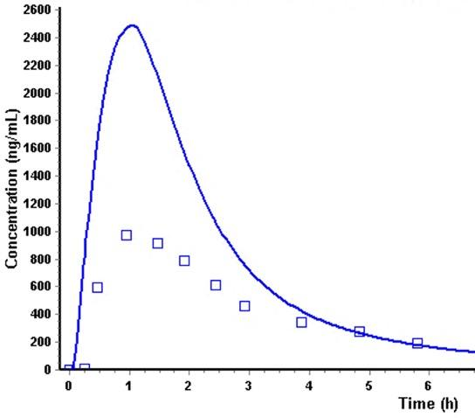
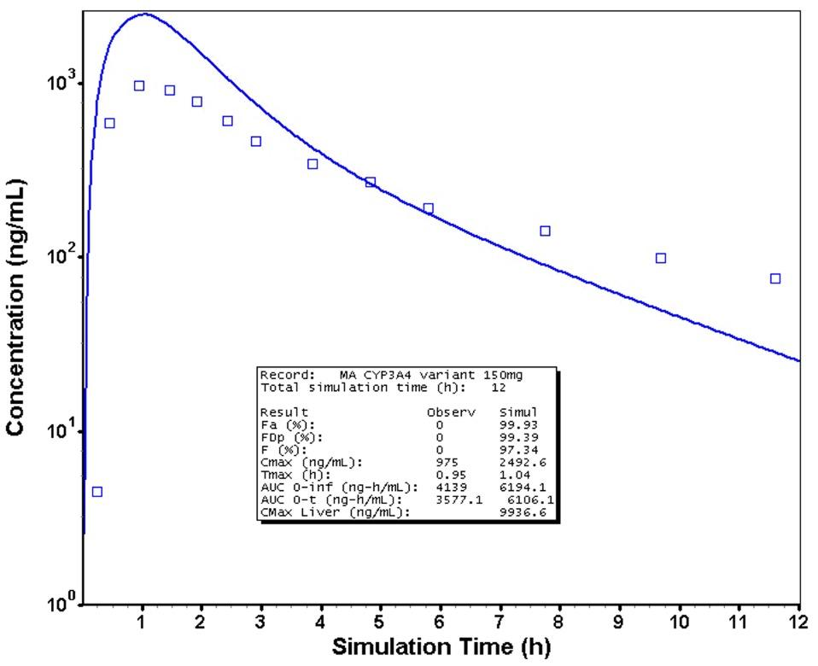
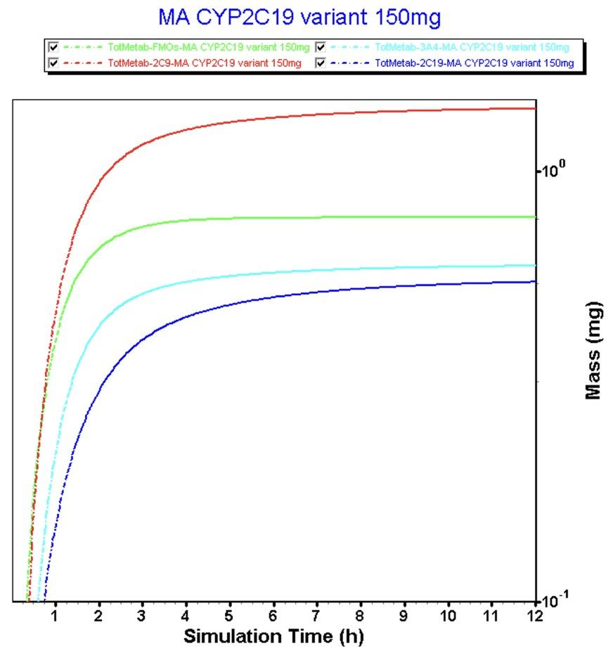
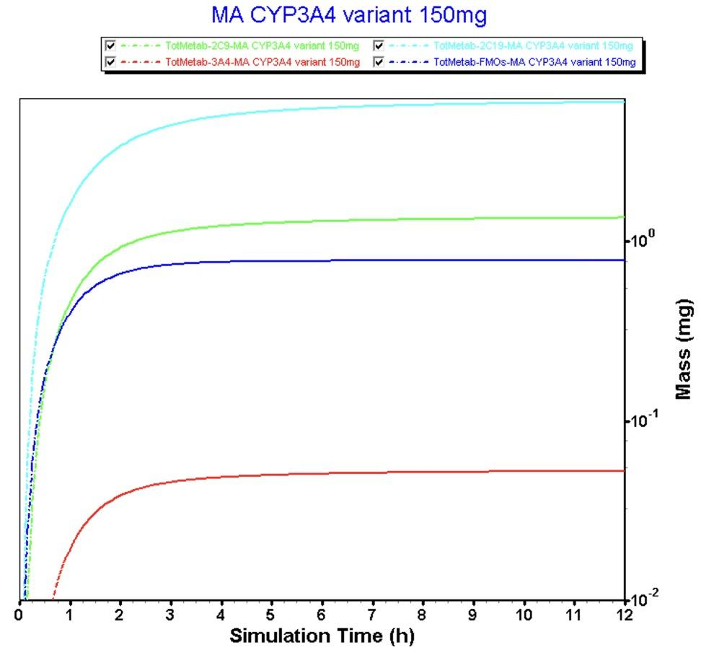
Hypothesis A: CYP2C19*2/*2 genotype induces lower clearance, but there won’t be significant change in Cmax and AUC, and Cmax will not exceed MTC.
Hypothesis B: CYP3A4 rs4646437 CT genotype induces lower clearance, but there won’t be significant change in
Cmax and AUC, and Cmax will not exceed MTC.
Changing of Enzyme Kinetics
Changing of Enzyme Kinetics
CYP2C19*2/*2 Simulated Curve
CYP3A4 rs4646437 CT Simulated Curve
2.53 mg/L(Cmax) < 5.5mg/L(MTC)
2.49 mg/L(Cmax) < 5.5mg/L(MTC)
1 mg/L
1 mg/L
Cmax_CYP2C19*2/*2: 2535.3
Cmax_Original: 2485.7
AUC_CYP2C19*2/*2: 6310.2
AUC_Original: 6084.2
Cmax_CYP3A4 CT: 2492.6
Cmax_Original: 2485.7
AUC_CYP3A4 CT: 6106.1
AUC_Original: 6084.2
2C19 > 2C9 ~= FMO >> 3A4
2C9 > FMO> 3A4 ~= 2C19
Notes:
Based on the literature, CYP2C19 variant exhibited Vmax rate of 9% of the wild type, so I made a modification of 2C19 in the Gut and liver, used original data to times 9% and then obtained new data. Here are the results: the Cmax is equal to 2.53 mg/L, still lesser than MTC. And here is the comparison of AUC and Cmax between two groups - CYP2C19 wild type and CYP2C19 variant. Cmax and AUC is obviously larger than the value comparing to values of the wild type, indicating that CYP2C19 variant indeed cause a lesser clearance. As for the CYP3A4 variant. Unfortunately, I did not find any literature describing how the variant will affect Vmax, I just assume it also exhibited 9% Vmax of the wild type. And here is the comparison of AUC and Cmax between two groups - CYP3A4 wild type and CYP3A4 variant. It did not affect much on Cmax and AUC.

